Slide 1
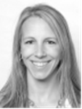
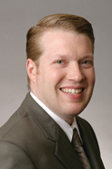
Update on Parkinson’s Disease and Deep Brain Stimulation
When: Wednesday, August 27, 2014 at 1:00 p.m.
Where: Hagerty Center – Room A
715 East Front Street, Traverse City, MI 49686
Jessica Hedeman, DO
St. Mary Mercy Health – Grand Rapids
Hauenstein Neuroscience Center
Movement Disorders Neurologist
Steve Klafeta, MD
St. Mary Mercy Health – Grand Rapids
Neurosurgeon – Deep Brain Stimulation
Free Admission with complimentary snacks & refreshments
Please RSVP by August 20 to Hettie Molvang 231-947-7389 or Jason Roth 313-806-4127
Space is limited. Please reserve your spot as soon as possible.

