Slide 1
The Two Midnight Rule,
Skilled Nursing Facility Rules
and How “The Rules” Impact Patients
Information for the Community

Slide 2
The Rule Makers Centers for Medicare and Medicaid Services
The Centers for Medicare & Medicaid Services (CMS), is a federal agency within the US Department of Health & Human Services that:
administers the Medicare program
works with state governments to administer Medicaid and the State Children's Health Insurance Program (SCHIP)
Oversees healthcare.gov website

Slide 3
The New Rules Who is affected?
The rules affect patients with coverage through Medicare and some Medicare Advantage plans
The rule also impacts hospitals who accept Medicare
CMS pays hospitals for the care delivered to those covered by Medicare
Hospitals are required to comply

Slide 4
The 2 Midnight Rule Inpatient Admission
On October 1, 2013, CMS implemented a new rule for who can be admitted to the hospital as an inpatient
Essentially, their definition of “inpatient” changed
Old Definition: An inpatient is a patient in the hospital for more than 24 hours
New Definition: An inpatient is a patient
requiring a hospitalization encompassing
two midnights and supported by medical
necessity

Slide 5
Service covered under Medicare Part B Services covered under Medicare Part B
Medicare pays 80% of their approved rate
Once the $147 Part B deductible is met, the 20% balance is either paid by the patient or paid by the patient’s supplemental coverage if they have one.
if person has a Medicare Advantage Plan, that plan will pay based on their specific contract.

Slide 6
Services covered under Medicare Part A
The patient is responsible for the deductible of $1,216
Part A covers:
semi-private room & board
Nursing services
Other hospital services & supplies which include medications
Some physician’s services and tests may be covered under Medicare Part B

Slide 7
Medicare’s payment for Inpatient Admission care is based on length of stay
First 60 days – Medicare pays all except for the $1,216 deductible
Days 61 to 90 – Medicare pays all except $304 per day.
Days 91 to 150 – Medicare pays all except $608 per day.
Above 150 days – Medicare pays nothing
The deductible must be paid when a re-admittance occurs after each 60 day period

Slide 8
costs for Inpatient care
The $1,216 deductible is paid by the patient or supplemental insurance product, if they have one.
If the hospital stay exceeds 60 days, daily co-pays are either paid by the patient or by their supplement insurance product, if they have one.
If the patient has one of the many Medicare Advantage Plans, there is usually a sizable initial co-pay that is the responsibility of the patient.

Slide 9
hospitalized under OBSERVATION
Medicare pays differently for observation stays as opposed to inpatient stays even if the same bed and room are used.
Observation status is always covered under Medicare Part B, as an outpatient service.
Medicare pays 80% of the approved amount and the patient pays the remaining 20% after the $147 Part B deductible is met.
If a patient has one of the Medicare Advantage Plans, generally co-pays, and expenses are paid according to the plan’s benefits.
Medications that are furnished under observation are considered self-administered even if given under the supervision of a nurse.
Notes:
.

Slide 10
The 2 Midnight Rule Inpatient Admission
Patients with an expected length of stay not spanning two midnights do not qualify as inpatients and are not eligible for payment under Medicare Part A.
This is true for both medical and surgical cases
There are some exceptions for surgeries/procedures on Medicare’s “INPATIENT ONLY”. In these cases, the length of stay does not matter.

Slide 11
Skilled Nursing Facility Rule 3 Night Inpatient Stay Requirement
The required 3 night inpatient stay to qualify for Skilled Nursing Facility (SNF) coverage has not changed.
Patients must have three days as an inpatient qualify for Medicare coverage
Nights spent in “Observation” DO NOT COUNT toward the 3-night inpatient stay
Medicare pays for the first 20 days of nursing home care if followed by 3 full days of an inpatient hospital stay.

Slide 12
Skilled Nursing Facility Rule 3 Night Inpatient Stay Requirement
Requirements to qualify for Medicare coverage at a qualified Skilled Nursing Facility at discharge
Patient must have spent 3 nights as an inpatient at the hospital meeting medical necessity requirement
Coverage is not based on patient, hospital, or family worry or inconvenience, social reasons or financial need
Medicare Advantage plans have different rules

Slide 13
Care Coordination What Munson is Doing
Performing a needs assessment shortly after admission or, if a planned procedure, having a discussion prior to admission
Care team collaborates to meet patient needs but must follow your insurance regulations and mandates
A case manager will discuss options with you regarding home care services, skilled nursing facility services, and availability of other community resources

Slide 14
Medicare Processes How You Are Notified
Medicare requires patients to sign an informational sheet when admitted to the hospital and again prior to discharge depending on how long you are in the hospital
On the back of this form is how to dispute or disagree with your discharge

Slide 15
Medicare Processes Disputed Discharge - Know Your Rights
DOES NOT give you a qualifying stay in a skilled nursing facility unless Medicare rules in your favor
You do not have to pay extra for your stay during the disputed time (will be responsible for co-pays and deductibles you would have incurred if not ready for discharge)

Slide 16
Patient Out-of-Pocket Outpatient or Observation Care
Outpatient/Observation status patients receive a letter explaining out-of-pocket expenses, and how to get medications reimbursed
Concerns about “self administered/home medications”
Financial Counselors can help explain your insurance benefit
Inpatients have a deductible and co-pay

Slide 17
The Costs: Inpatient versus OBSERVATION Status
If a Medicare beneficiary has a supplemental/medigap plan, co-pays and deductibles may be covered. Each plan pays differently so it is important to know your plan.
Supplemental plans may pay for both the Part A and Part B deductibles and the associated 20% co-pays not paid by Medicare.
Even if the observation patient has supplemental insurance, they will still need to seek reimbursement from their prescription drug insurance and most likely have a higher co-pay than normal.

Slide 18
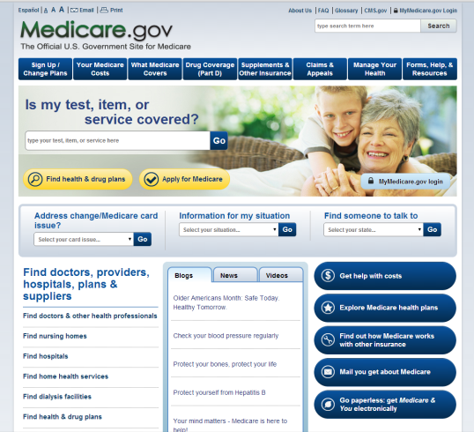
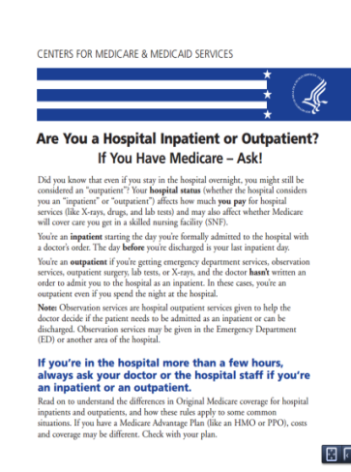
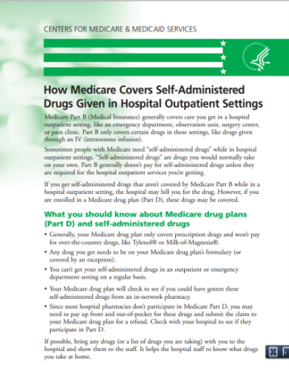
Resources Where to Go for Information
Medicare Website - www.medicare.gov
Medicare Publications
Are you a Hospital Inpatient or Outpatient?
How Medicare covers self-administered drugs given in Hospital outpatient settings

Slide 19
Medicare/Medicaid Assistance Program MMAP - 1-800-803-7174
MMAP Team Members provide individual counseling for people who need help with all aspects of Medicare and Medicaid benefits.
services are free.
help beneficiaries find the correct Medicare plans and often save them money in the process.
A good online resource for Medicare information is: www.medicare.gov

Slide 20
Questions Here to Help
Linda Hansen, Manager
Utilization Management
Munson Medical Center
(231) 935-6955
lhansen@mhc.net
Lise Kolinski, Manager
Social Work/Case Management
Munson Medical Center
(231) 935-6392
lkolinski@mhc.net

